Slide 1
COVID-19 PANDEMIC SPREAD ANALYSIS
A Data-Driven Exploration of COVID-19 Spread, Doubling Rates, and Mortality Trends by Country.
Presented by: Group 6 (Healthcare)
November, 2024.

Slide 2
PROJECT OVERVIEW
INTRODUCTION
OBJECTIVES
KEY INSIGHTS
METHODOLOGY
RESEARCH QUESTIONS
ANALYSIS & VISUALIZATION
SUMMARY OF KEY FINDINGS
CONCLUSION & RECOMMENDATIONS

Slide 3
INTRODUCTION
The COVID-19 pandemic brought unprecedented challenges worldwide, rapidly transforming health systems, economies, and daily life as we knew it. In its early stages, understanding the mechanisms and doubling times became critical for formulating effective containment and mitigation strategies. Our findings and recommendations includes; early containment measures are crucial, rapid health infrastructure response to avoid high mortality onset and real-time data monitoring to predict doubling rates.

Slide 4
OBJECTIVES
To analyze the progression and spread of COVID-19 across countries.
Identify factors affecting initial containment.
Understand the timing of mortality rates.
To analyze total deaths and new deaths over time.

Slide 5
RESEARCH QUESTIONS
How did the initial spread of COVID-19 progress in different countries?
How long did it take for cases to double?
Were some countries able to maintain zero or very low new cases over extended periods?
How did COVID-19 spread geographically in its initial stages?
Which regions saw the earliest cases?
How quickly did deaths begin to appear in the reported data after initial cases, and how does this vary by country?

Slide 6


METHODOLOGY
DATA SOURCING – KAGGLE
DATA CLEANING
ANALYSIS & VISUASLIZATIONS

Slide 7
KEY INSIGHTS
TOTAL CASES = 6 MILLION
NEW CASES = 249,000
NEW DEATHS = 9,146
TOTAL DEATHS = 177,000
NUMBER OF COUNTRIES =120

Slide 8

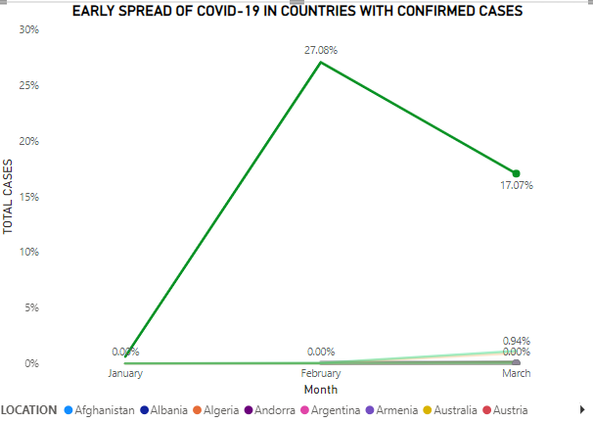
INITIAL SPREAD AND DOUBLING TIME
KEY INSIGHT
Sharp Increase in February: There is a significant jump in the percentage of total cases from January to February, peaking at 27.08%.
Decline in March: By March, the percentage of total cases has decreased to 17.07%.
The most critical period was February in the early stages of the pandemic, where the virus spread rapidly, followed by a possible response or containment phase in March.

Slide 9
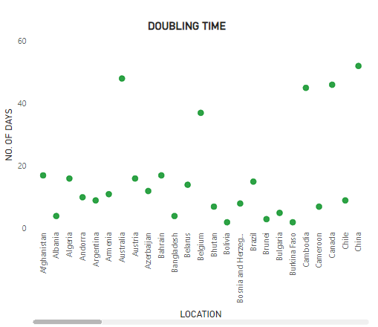
INITIAL SPREAD AND DOUBLING TIME
KEY INSIGHTS
Variation in doubling time: Some countries have a doubling time of less than 10 days, indicating rapid case growth, while others show significantly longer doubling times, over 40 or even 60 days, reflecting slower spread.
Clustered Patterns: Most countries have a doubling time around 10-20 days, suggesting that, in many regions, cases were doubling at a similar rate or similar levels of containment measures or effective healthcare responses in these regions.
Outliers: Countries, such as China, Australia and a few others, exhibit notably longer doubling times (above 40 days), possibly due to effective containment measures, early lockdowns, or differences in population density and healthcare infrastructure.

Slide 10
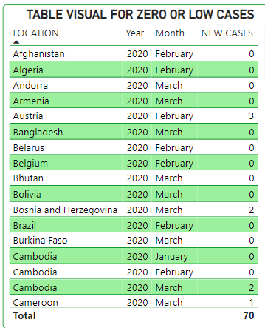
EARLY CONTAINMENT MEASURES
KEY INSIGHTS
Widespread Low Cases Across Countries: Multiple countries, including Afghanistan, Algeria, and Bhutan, reported zero cases in early 2020 (January to March).
Consistency in Zero Cases for Entire Months: Many of these countries consistently reported zero cases for whole months.
Total Low Case Count: The total of 70 cases across these countries emphasizes the slow initial spread of COVID-19 in certain regions, possibly due to geographic isolation or proactive measures.

Slide 11
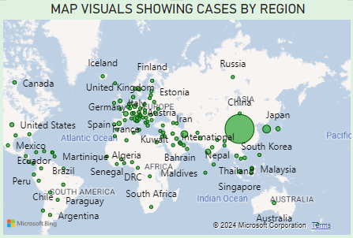
GEOGRAPHICAL SPREAD IN INITIAL STAGES
KEY INSIGHTS
Geographic Clustering in Asia and Europe.
Smaller Outbreaks in Remote or Isolated Regions.
Larger Circle Sizes for High-Case Regions which aligns with the initial epicenter of the pandemic.

Slide 12
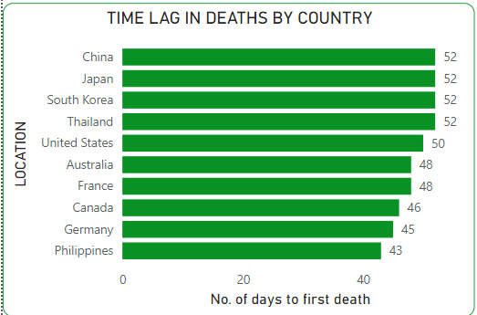
ONSET OF MORTALITY POST- INITIAL CASES
KEY INSIGHTS
Uniform Time Lags: suggesting similar response times and possibly comparable healthcare dynamics in these nations..
Shorter Time Lags: Western countries might reflect different approaches or efficiencies in healthcare response and reporting.
Variance in Reporting: The Philippines had the shortest time lag at 43 days, while Germany and Canada were close at 45 and 46 days respectively, highlighting variances in how quickly fatalities were recorded or occurred.

Slide 13
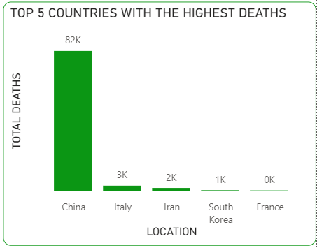
MORTALITY RATES BY NUMBERS

Slide 14
SUMMARY OF KEY FINDINGS
Early Case Surge: COVID-19 cases surged rapidly in February, peaking at 27.08%, then declined in March.
Slow Growth Regions: Some countries maintained zero or low cases early on, likely due to effective containment or isolation.
Doubling Time Variance: Countries showed diverse doubling times, with faster growth in some and extended doubling periods up to 60 days in others.
Successful Containment: Many countries, like Afghanistan, Albania, and Algeria, reported consistently low or zero cases initially, suggesting early containment effectiveness.
Geographic Spread Map: COVID-19 cases spread across diverse global regions, with noticeable concentrations in countries like Mongolia in the first quarter of 2020.

Slide 15
CONCLUSION
The analysis underscores the importance of timely containment measures, highlights the varied impact of COVID-19 across countries, and provides insights into how different factors influenced early transmission dynamics globally.

Slide 16
RECOMMENDATION
Early containment measures are crucial.
Real-time data monitoring to predict doubling rates.
Swift adoption of health infrastructure to mitigate the onset of high mortality rate.

Slide 17
THANK YOU!!!

